Slide 1

Face Recognition and Detection
Kamal Tej Veerapaneni
Vinay Maturi
Harish Chandra Jyoshi
Akhila Atluri

Slide 2
Face Recognition and Detection
Face Recognition:
Gather the Data
Train the data
Recognize face
Face Detection:
Load Cascades
Function for detection
Emotion Detection
Gender Detection

Slide 3
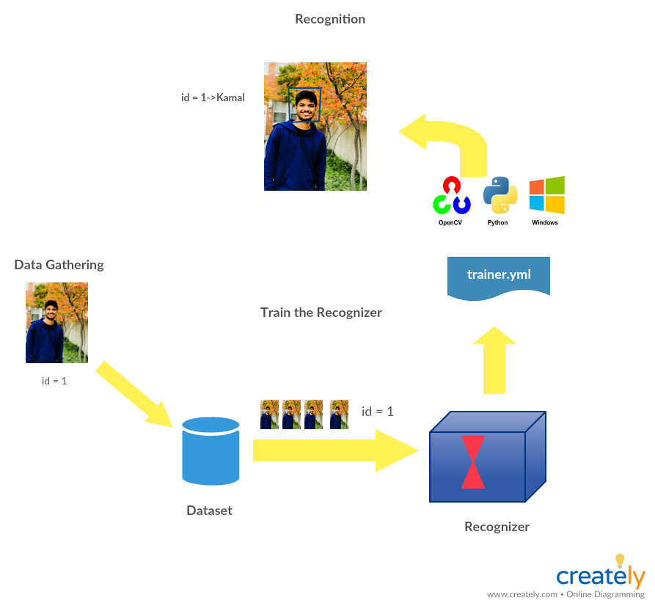
Face Recognition
Data Gathering:
Gather Images of person to be identified
Train the recognizer:
Feed the image data and Id’s to the recognizer(so that it learns)
Recognition:
Face recognized and output shown with probability match

Slide 4

Software and Libraries
Pycharm
OpenCV: If NumPy’s main goal is large, efficient, multi-dimensional array representations, then, by far, the main goal of OpenCV is real-time image processing.
Numpy: We can express images as multi-dimensional arrays, by using NumPy’s built-in high-level mathematical functions, we can quickly perform numerical analysis on an image.
Pillow: Image module provides a class with same name which is used to represent a PIL image. Also provides a number of factory functions to load images from files

Slide 5
Working:
Create a directory for storing the images,each image is stored with id
Now take all the data from dataset and train it using OpenCV Recognizer
This is done by specific OpenCV function and the result is stored in .yml file
Finally we capture a fresh image on our camera and if the person had his face trained before,our recognizer will make a prediction returning id and index,showing how confidently recognizer made the match

Slide 6
Face Detection
Load Haar Cascade file
Store objects to a variables while using detectMultiscale method
While capture
Query Each frame and
Convert to gray scale
yes
Draw Rectangle on Object
Show Emotion and Gender

Slide 7
Haar Features

Slide 8
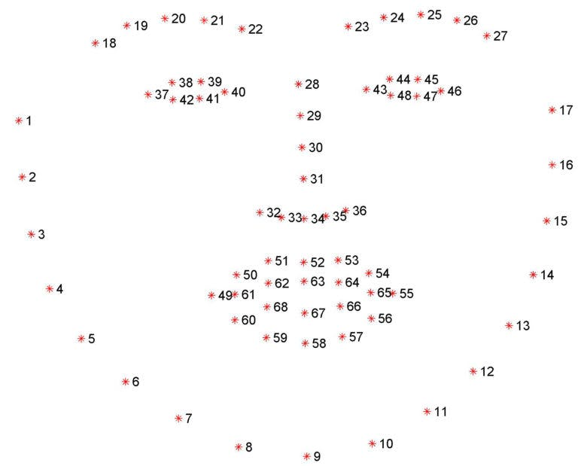
Visulization of 68 landmarks

Slide 9
How it works………..
Cascades are not actually neural networks they are deep series of filters not series of layers
OpenCV cascades are not based on any neural network libraries so we don’t need tensor flow
Haar cascades: Fast, but less accurate. Can be a pain to tune parameters
Process:
Load Cascades -> Define Functions -> Detect Functions
Emotion and Gender Detection:
Angry, Sad, Happy, Disgust, Neutral,Surprised
Male or female

Slide 10

Softwares and Libraries
Pycharm
-OpenCV
-Numpy
-glob:Basically, it has two functions that either return a list or an iterator of files in a directory using shell pattern matching

Slide 11
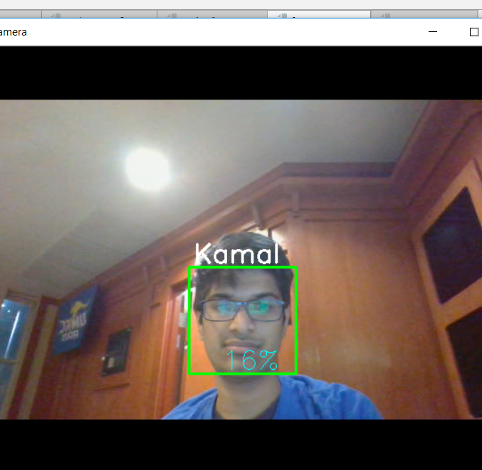
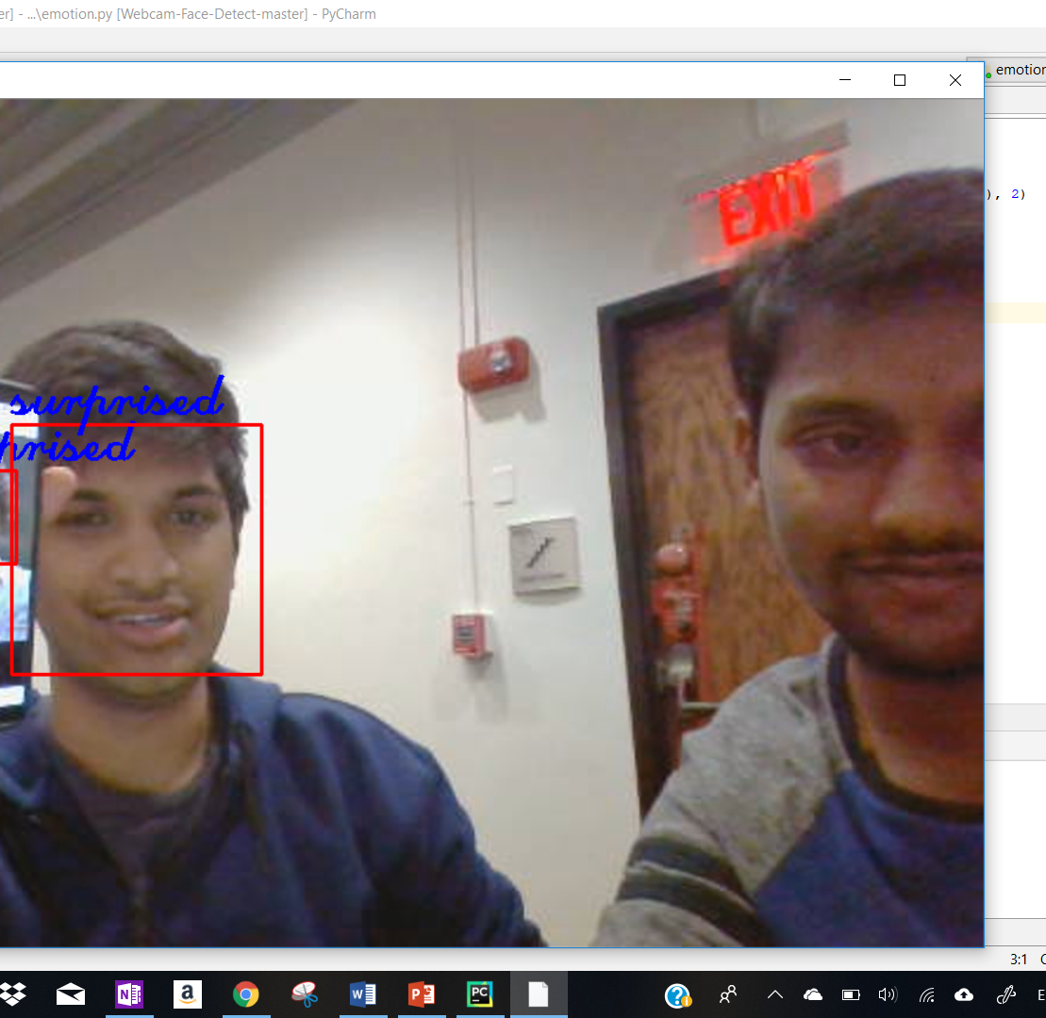
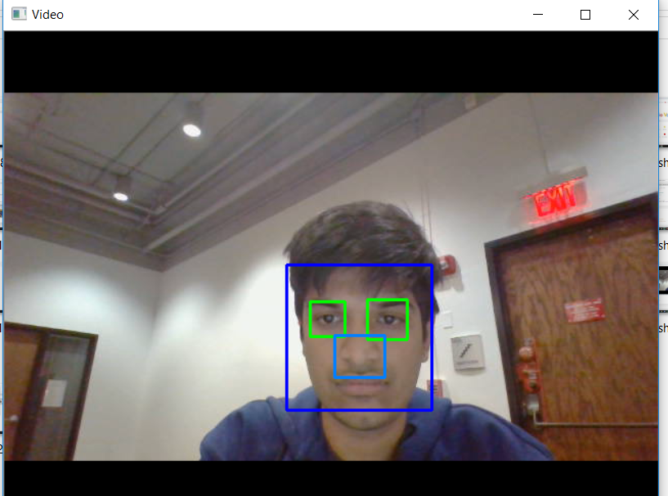
Output:

Slide 12

Video Link :
Github Link:
Data Sets Links:
https://www.ugent.be/pp/ekgp/en/research/research-groups/panlab/kdef
http://www.anefian.com/research/face_reco.htm
References:
https://www.pyimagesearch.com/2018/09/24/opencv-face-recognition/
https://www.udemy.com/computer-vision-a-z/learn/v4/overview
https://data.vision.ee.ethz.ch/cvl/rrothe/imdb-wiki/
https://docs.opencv.org/3.1.0/da/d60/tutorial_face_main.html
http://vis-www.cs.umass.edu/lfw/#download
https://docs.opencv.org/3.1.0/dc/da5/tutorial_py_drawing_functions.html

Slide 13

Thank you

